Slide 1



BIOMETRIC STUDENT ATTENDANCE
Presented by: GROUP 5

Slide 2
UI DESIGN AND IMPLEMENTATION
Presented by: GROUP 5

Slide 3
INTRODUCTION
1- USER INTERFACE DESIGN
1.1- design principle
1.2-Key Ui components
1.3-Ui design mockup and prototypes
2-TECHNICAL IMPLEMENTATION
2.1-system architecture
2.2-Ui implementation using modern frameworks and library
CONCLUSION
OUTLINE

Slide 4
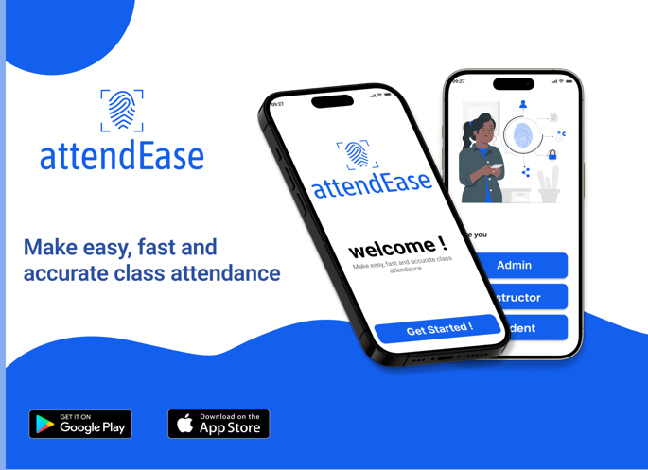


1-INTRODUCTION
In the era of digital transformation, the integration of biometric authentication has become increasingly crucial for enhancing security and user experience in mobile applications. This report outlines the User Interface and implementation of AttendEase mobile app that leverages fingerprint biometric authentication to streamline and secure user interactions. The report details the system architecture, the frontend development, and the integration of fingerprint biometric authentication, providing a comprehensive view of the mobile app(UI) and an overview of the technical considerations and decisions made during the development process.

Slide 5
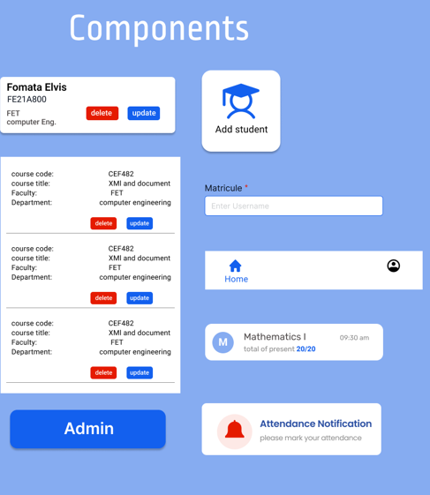
USER INTER FACE DESIGN
DESIGN PRINCIPLE
User centered design
Modular design

Slide 6

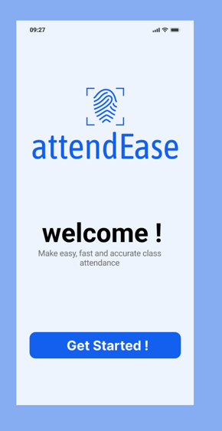
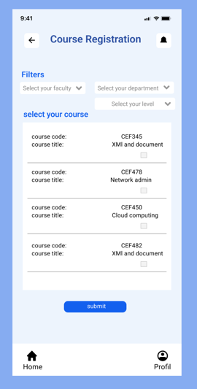
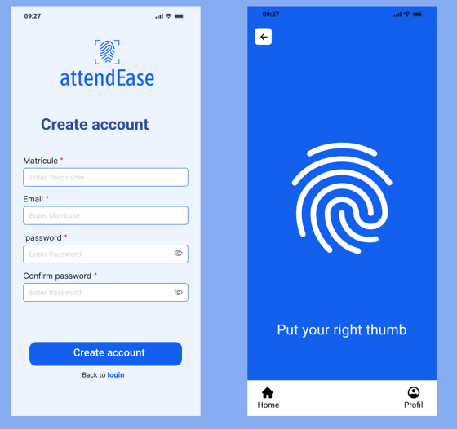
consistency
Uniform elements: We used consistent color schemes, fonts, and button styles throughout the app to create a cohesive look and feel.
Predictable interactions: We ensured that similar actions produce similar results across different parts of the app.
The choice of the colors: it is not done hazardously, we have a couple of rules that based on them. For our design, we made use of many colors, which are more detailed as follows:
Gray-blue (#EDF4FD) White (#FFFFFF) Blue (#1360EE)

Slide 7

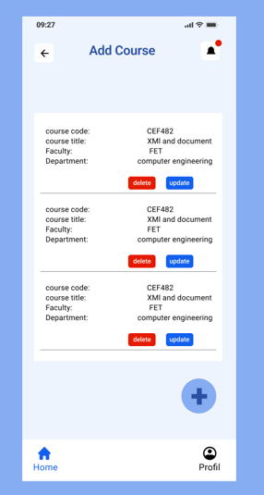
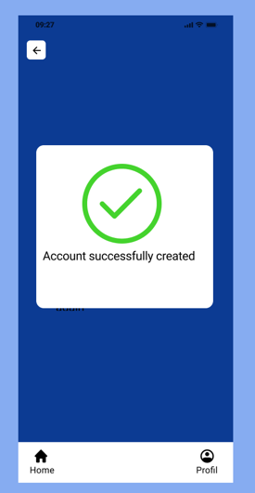
Red (#E51B00 Green:
Accessibility
Inclusive design
Scalability
Feedback and responsiveness
Instant feedback
Loading indicator
Security and privacy
Data encryption
User consent
brainstorming
surveys
user persona

Slide 8
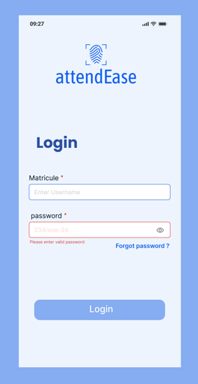
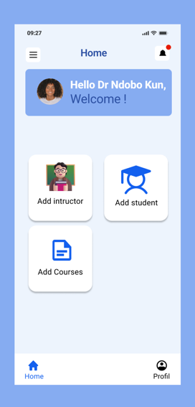
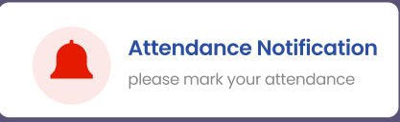
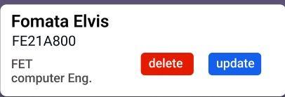
visual design
Visual hierarchy
Unity design
Dominance
Rhythm
Alignment
gestalk
Error prevention and handling
Prevent error
Graceful error handling
efficiency
acdominanceminancebility
alignment features
Rhythm
accuracy

Slide 9

Ui design mock-ups and prototypes process
Setting up the project on Figma
Project organization
Artboards
Creating Ui mock-ups
Wireframes
High fidelity design
Prototyping interaction
Linking screens
Transitions and animation
Interactive elements
Preparing for development
Design specification
Exporting assets

Slide 10

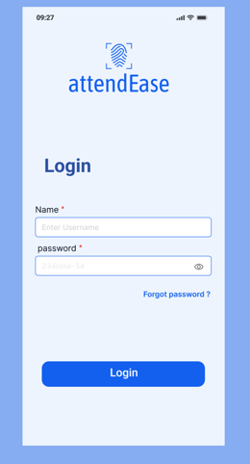
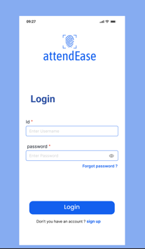
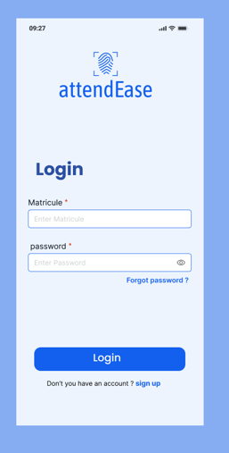
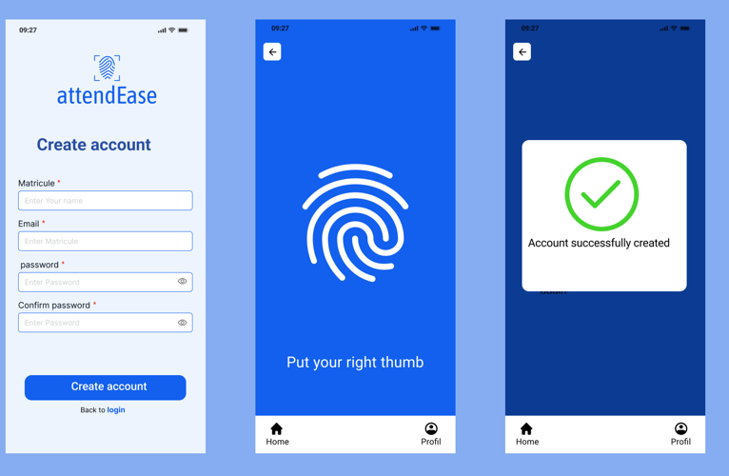
Key Ui components
Login /registration screens
Login
Registration form in the platform

Slide 11

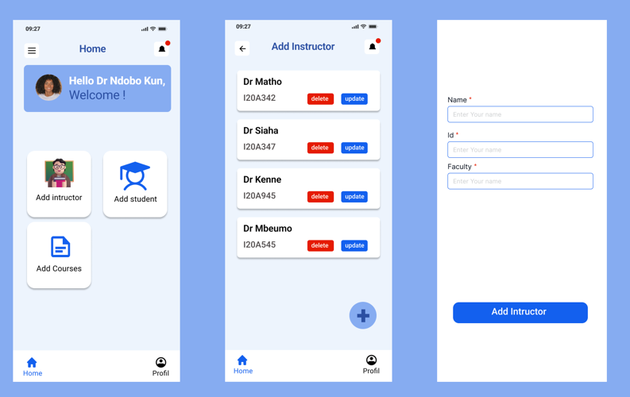
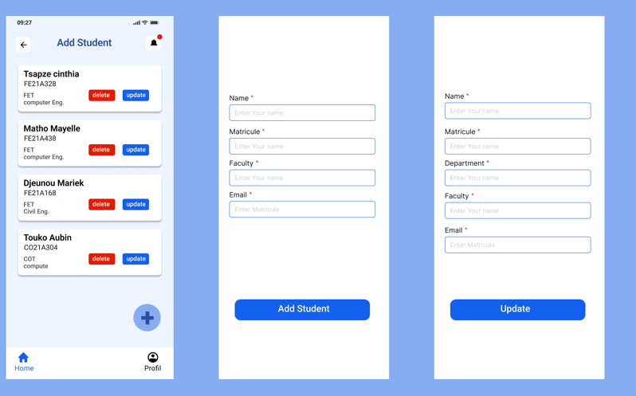
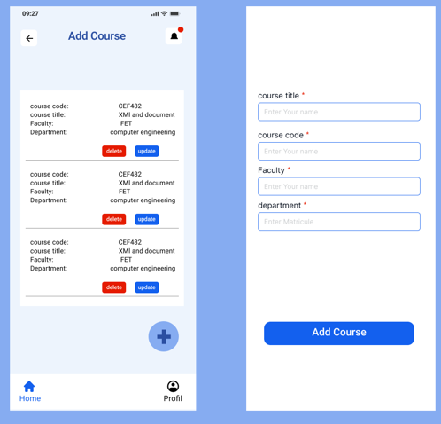
Registration form in the school

Slide 12
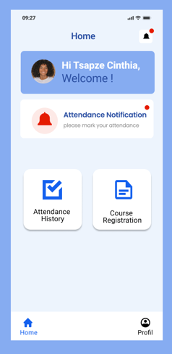
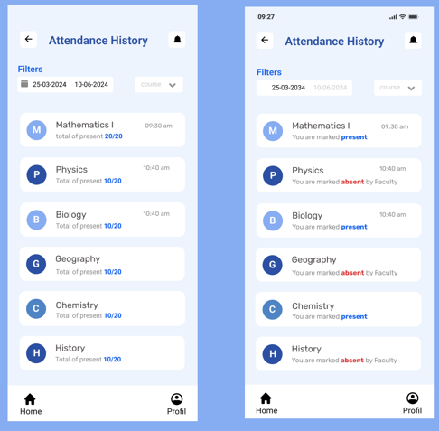
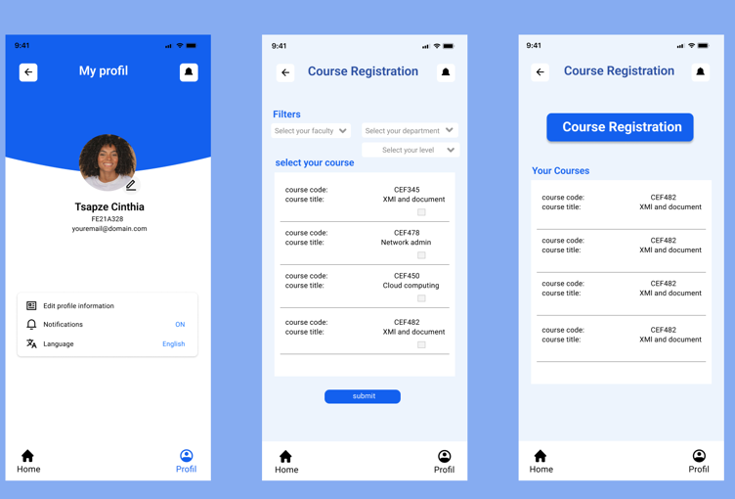

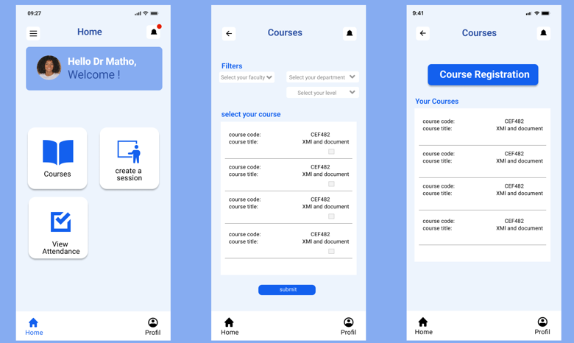
Attendance dashboard

Slide 13

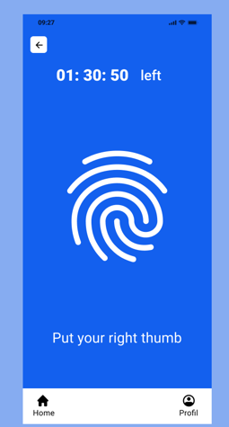
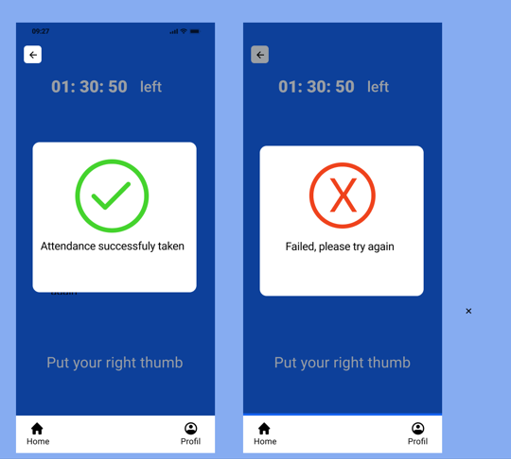
Fingerprint scanning interface

Slide 14
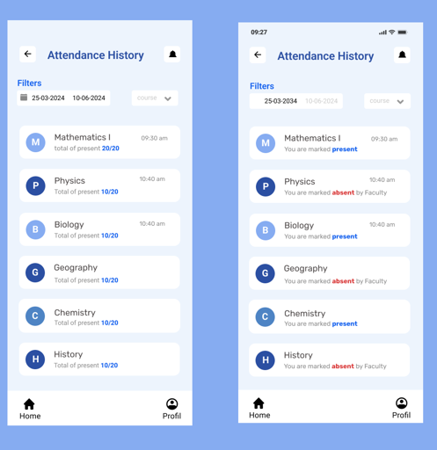
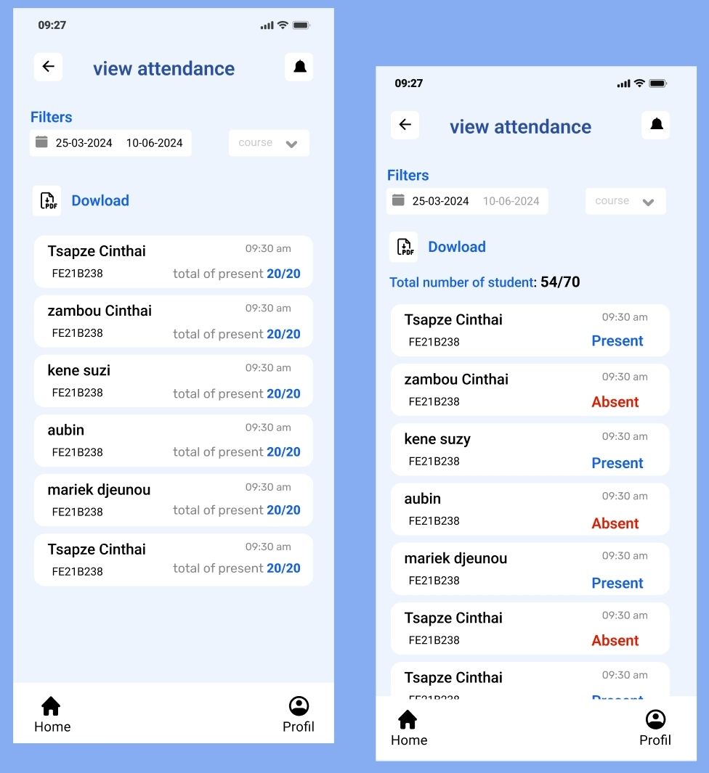
Attendance history

Slide 15
technical implementation
System architecture
Client -side
Server –side
Database
Authentication
Biometric integration
Ui implementation using moder frameworks and libraries
Framework choice
Component base architecture

Slide 16

Conclusion
In conclusion, the design and implementation of the biometric student’s attendance mobile application successfully integrate both aesthetic appeal and technical robustness. By adhering to key design principles, we ensured a user-friendly interface that promotes ease of use and efficient navigation.The technical implementation leverages React Native for the frontend, providing a seamless and responsive user interface across different mobile platforms.

